Slide 1

MGT 350 - Test 1
Chapters 1, 2, 4 & 5

Slide 2
Test Overview
45 – 50 multiple choice questions, 2 – 3 short answer
Test content will emphasize what has been covered in class, summarized in these review slides
Know definitions
Know construct relationships
  What leads to (causes) the construct?
  What outcomes (effects) does the construct lead to?
  Does the strength of relationships depend on other things?
  Also think about why the relationship exists (sometimes, this is a 3rd construct)

Slide 3
Short answer questions – 2 of these
Describe a paradigm shift in management/org behavior. What were some causes for the shift? What changed about what managers focus on?
What was learned from the Hawthorne studies? Give details from the studies demonstrating why these things were concluded, e.g. related to the research design (illumination studies) or interview details (bank wiring room)
What are the best practices for using pay and incentives to influence employee behavior? Be sure to explain why, rather than just reproduce slides 11 & 12 from Chapter 4.
How do individual vs. group incentives motivate behavior differently?
What is the business case for diversity?
What are some causes of job satisfaction? What does job satisfaction cause? You could use boxes and arrows, but be sure to explain the nature of the relationships and why they exist.

Slide 4
Chapter 1 – Intro to OB
Paradigms and paradigm shift
  What paradigm shifts have occurred in management?
    Hawthorne studies
    Theory X, Y
    Phyical assets → intellectual/knowledge resources
    Globalization, workforce diversity
  The OB paradigm
    Employees are extremely complex
    Build theories through rigorous research
    Manage according to this research/theory (evidence-based mgt)

Slide 5
Chapter 1 – Intro to OB
Hawthorne studies
  What was being studied in the illumination studies? What variable was manipulated? How did this group of studies lead to the ‘Hawthorne effect?’
  What was the conclusion of the bank wiring room study? What are some details that led to this conclusion?
  Be able to summarize how the Hawthorne studies began to cause a paradigm shift. You can relate this to Theory X/Y, and/or contrast modern OB with scientific management

Slide 6
Research Methodology to Determine Valid Evidence
Overall scientific perspective:
  The overall purposes are understanding/explanation, prediction, and control.
  The definitions are precise and operational (why?)
  The measures are reliable (consistent) and valid (measure the construct we are trying to measure).
  The methods are systematic.
  The results are cumulative (meta-analysis).
    A meta-analysis averages the findings of available research to estimate the strength of relationships between constructs. This is an important way to test the ‘truth’ of theories.
Notes:
The methods (e.g. for testing hypotheses) are systematic, and different fields of knowledge (e.g. climate science, chemistry or OB) develop different systems for what methods are acceptable.
What are acceptable methods in climate science?
OB?

Slide 7
Chapter 1 – Intro to OB
Research designs aim to establish cause-effect
  Experiments
    The level of predictor (aka independent) variables is manipulated to create different conditions. E.g. one of the Hawthorne studies manipulated lighting conditions
    An outcome (aka dependent) variable is measured and compared across the different conditions. Differences in outcomes (called ‘effects’) should be due to differences in the predictor variable
    The conditions of the study are highly controlled to rule out other explanations for any observed effects
  Surveys
    Conditions under which surveys are filled out are usually not controlled, or even known.

Slide 8
Chapter 1 – Intro to OB
Research designs aim to establish cause-effect
  Internal validity
    A study has internal validity if there are no plausible alternative explanations of the reported results other than those reported.
    Experiments have the highest internal validity
  External validity
    External validity is concerned with the generalizability of the results obtained
    In order for a study to have external validity, the results must be applicable to a wide range of people and situations.
    The more study conditions mirror the real world, the more external validity

Slide 9
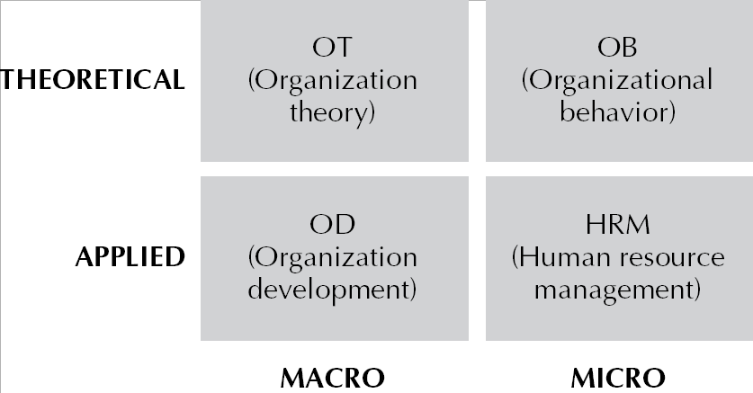
Chapter 1 – Intro to OB
Applied sciences are concerned more with how real world works
Theoretical sciences are more concerned with establishing valid theories
Both are still concerned with the other thing, just not as much
OB is more theoretical than applied.
Macro/micro distinction is more self-explanatory

Slide 10
Chapter 1 – Intro to OB
Theoretical frameworks
  Cognitive framework takes an internal view, i.e. looks inside individuals to explain behavior
  Behavioristic framework takes an external view, i.e. looks at the environment or situation to explain behavior
  Social-cognitive framework says behavior is best explained by the interaction of internal and external

Slide 11
Chapter 1 – Intro to OB
Vocabulary
  Paradigm
  Paradigm shift
  Scientific management
  Theory X
  Evidence based management
  Hawthorne effect
  Construct
  Meta-analysis
  Experimental design
  Internal validity
  External validity
  Organizational behavior

Slide 12
Ch 2 – Globalization, Diversity, Ethics
Understand basics of the business case for diversity
  Hiring diverse employees
  Marketing to diverse customers
  Better problem-solving
  More creativity
Understand basics of approaches to managing diversity
  Learning approach
  Empathy approach
  Training
Mentoring
Work/Family programs

Slide 13
Ch 2 – Globalization, Diversity, Ethics
Understand basic factors influencing ethical behavior
  Cultural influences
  Organizational influences
  External environment influences
  Peer pressure
  Individual differences, e.g. in values

Slide 14
Chapter 2 – Globalization, Diversity & Ethics
Vocabulary
  Global mindset
  Multicultural org
  Exclusionary org
  Club org
  Compliance org
  Redefining org
  Flextime
  Compressed workweek
  Job sharing
  Telecommuting
  Flextime
  Compressed workweek
  Job sharing
  Telecommuting
  Corporate social responsibility

Slide 15
Chapter 4 – Reward Systems
  Respect
  Recognition
  Control
Money motivates because it symbolizes:
  Achievement
  Status
  Freedom
  Power
Agency theory says owners & managers (agents) differ:
  in preferences for putting org resources at risk
  in how pay and other rewards should be used to run the org
  in their time horizons for making decisions
These things require owners (represented by board of directors) to closely monitor how managers run the company (agency costs)

Slide 16
Chapter 4 – Reward Systems
Agency theory suggests:
  Aligning the interests of managers with owners by compensating managers with stock
  This creates its own problems, e.g. temptation for ‘creative accounting’ to drive up stock price

Slide 17
Chapter 4 – Reward Systems
How do individual vs. group incentives motivate behavior differently?
Potential limitations of individual vs. group incentives
Research on pay effectiveness – know these 2 slides (slides 11 & 12 from Ch. 4 slides)
Benefits
Match benefits offered to needs of those you want to employ
Maximize the value of offered benefits by:
  Communicating to employees how to effectively use them
  Driving down costs, e.g. wellness programs → health insurance costs

Slide 18
Chapter 4 – Reward Systems
Vocabulary
  Base pay
  Merit pay
  Pay for performance
  Stock options
  Gainsharing
  Profit sharing
  ESOP
  Wellness programs

Slide 19
Chapter 5 - Personality, Perception, and Employee Attitudes
Why is personality important in OB?
What is personality useful for in OB?
Self-esteem
  Effects of high and low self-esteem
Big 5 traits
  What is each related to?
  How are they used in organizations?

Slide 20
Chapter 5 - Personality, Perception, and Employee Attitudes
Perception process
  Is always running on autopilot, subconsciously
  What happens during selection vs. interpretation?
  Effects of high and low self-esteem
Social perception:
  How do characteristics of the perceiver affect it?
  How do characteristics of the perceived affect it?

Slide 21
Chapter 5 - Personality, Perception, and Employee Attitudes
Social perception
  We put people into categories because it’s easy
  But this is the source of biases, which lead to errors
  E.g. stereotyping and halo error
Positive & negative affectivity
  These are personality traits
  What are they related to?

Slide 22
Chapter 5 - Personality, Perception, and Employee Attitudes
Job satisfaction
  What aspects of work are important factors in job satisfaction?
  What is job satisfaction related to (what does it cause)?
  How to enhance?
Org commitment
  3 dimensions
  How to enhance?

Slide 23
Chapter 5 - Personality, Perception, and Employee Attitudes
Org citizenship behaviors (OCB)
  5 major types
  What is OCB related to (what does it cause)?

Slide 24
Chapter 5 - Personality, Perception, and Employee Attitudes
Vocabulary
  Personality [trait theory]
  Personality [functionalist]
  Self-esteem
  Person-situation interaction
  Conscientiousness
  Emotional stability
  Agreeableness
  Extraversion
  Openness to experience
  Selection
  Interpretation
  Stereotyping
  Halo effect
  Positive affectivity
  Negativity affectivity
  Job satisfaction
  Organizational commitment
    Affective
    Continuance
    Normative
  Organizational citizenship behaviors

